Slide 1
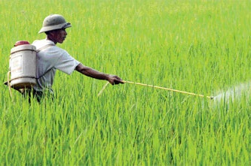
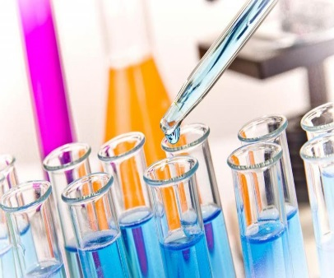
Meghmani Organics Limited (MOL)
Q1 FY20 Results Presentation
Aug 2019

Slide 2
Disclaimer
The presentation has been prepared by Meghmani Organics Limited (“MOL” or the “Company”) solely for information purposes and does not constitute an offer to sell or, recommendation or solicitation of an offer to subscribe for or purchase any securities and nothing contained herein shall form the basis of any contract or commitment whatsoever.
The information contained in this Presentation should be considered in the context of the circumstances prevailing at the time and has not been, and will not be, updated to reflect material developments which may occur after the date of the Presentation. The information set out herein may be subject to updating, completion, revision, verification and amendment and such information may change materially. This presentation is based on the economic, regulatory, market and other conditions as in effect on the date hereof. It should be understood that subsequent developments may affect the information contained in this presentation, which neither the Company nor its affiliates, advisors or representatives are under an obligation to update, revise or affirm.
You acknowledge and agree that the Company and/or its affiliated companies and/or their respective employees and/or agents have no responsibility or liability (express or implied) whatsoever and howsoever arising (including, without limitation for any claim, proceedings, action, suits, losses, expenses, damages or costs) which may be brought against or suffered by any person as a result of acting in reliance upon the whole or any part of the contents of this Presentation and neither the Company, its affiliated companies nor their respective employees or agents accepts any liability for any error, omission or misstatement, negligent or otherwise, in this Presentation and any liability in respect of the Presentation or any inaccuracy therein or omission therefrom which might otherwise arise is hereby expressly disclaimed.
Certain statements contained in this Presentation may be statements of the Company’s beliefs, plans and expectations about the future and other forward looking statements that are based on management’s current expectations or beliefs as well as a number of assumptions about the Company’s operations and factors beyond the Company’s control or third party sources and involve known and unknown risks and uncertainties that could cause actual results to differ materially from those contemplated by the relevant forward looking statements. Forward looking statements contained in this Presentation regarding past trends or activities should not be taken as a representation that such trends or activities will continue in the future. There is no obligation to update or revise any forward looking statements, whether as a result of new information, future events or otherwise. You should not place undue reliance on forward looking statements, which speak only as of the date of this Presentation.

Slide 3
Discussion Summary
Q1 FY20 Results Update
About Us
Business Overview
Strategy & Outlook
Financial Overview

Slide 4
Q1 FY20 Results: Key Highlights
Rs Mn
Q1 FY20 YoY Analysis
Revenues & Gross Margin
EBITDA & EBITDA Margin
PAT & PAT Margin*
29 %
9 %
11 %
Note: * PAT & PAT Margin are after NCI
Notes:
140+ 65+25+2012-13, 2013-14

Slide 5
Q1 FY20 Results: Revenue Analysis
Rs Mn
Q1 FY20 YoY Analysis
Segment wise Breakup
Region wise Breakup
Notes:
140+ 65+25+2012-13, 2013-14

Slide 6
Q1 FY20 Results: Pigments Business
Q1 FY20 YoY Analysis
Production & Utilisation (%)
Dispatch / Sales (MT)
Net Revenue (Rs Mn) & Exports
EBITDA (Rs Mn) & Margin (%)
79 %
74%
Net Revenue including intersegment sales
Exports
Notes:
140+ 65+25+2012-13, 2013-14

Slide 7
Q1 FY20 Results: Agrochemicals Business
Q1 FY20 YoY Analysis
Production & Utilisation (%)
Dispatch / Sales (MT)
Net Revenue (Rs Mn) & Exports
EBITDA (Rs Mn) & Margin (%)
67 %
78 %
Net Revenue including intersegment sales
Exports
Notes:
140+ 65+25+2012-13, 2013-14

Slide 8
Q1 FY20 Results: Basic Chemicals Business
Q1 FY20 YoY Analysis
Production & Utilisation (%)
Dispatch / Sales (MT)
Net Revenue (Rs Mn) & Exports
EBITDA (Rs Mn) & Margin (%)
2 %
5 %
Net Revenue including intersegment sales
Exports
Notes:
140+ 65+25+2012-13, 2013-14

Slide 9
Q1 FY20 Results: Consolidated Profit & Loss Statement
Particulars (Rs. in Mn) | Q1 FY20 | Q1 FY19 | YoY% | FY19
Revenue from Operations | 6,162 | 4,765 | 29.3% | 20,880
COGS | 3,670 | 2,294 | 60.0% | 10,330
Gross Profit | 2,492 | 2,471 | 0.8% | 10,550
Gross Margins % | 40.4% | 51.9% | -1142 bps | 50.5%
Employee Expenses | 356 | 215 | 65.2% | 1,247
Other Expenses | 785 | 1,016 | -22.7% | 3,859
EBITDA | 1,351 | 1,240 | 9.0% | 5,445
EBITDA Margin % | 21.9% | 26.0% | -410 bps | 26.1%
Depreciation | 219 | 243 | -10.0% | 973
EBIT | 1,132 | 997 | 13.6% | 4,472
Finance Cost | 74 | 135 | -45.3% | 560
Other Income | 38 | 141 | -73.3% | 332
Exceptional Items | - | - | - | 159
PBT | 1,097 | 1,004 | 9% | 4,086
Taxes | 319 | 233 | 36.6% | 1,132
PAT | 778 | 771 | 1.0% | 2,954
PAT Margin % | 12.6% | 16.2% | -355 bps | 14.1%
PAT after Minority | 569 | 637 | -10.7% | 2,513
Notes:
140+ 65+25+2012-13, 2013-14

Slide 10
Discussion Summary
Q1 FY20 Results Update
About Us
Business Overview
Strategy & Outlook
Financial Overview

Slide 11
Well-Established Presence Across International & Domestic Markets
Presence in more than 75 countries, serving over 400 customers across all three business segments
Global distribution network with subsidiaries in the US, Dubai and a representative office in China
4 Warehouses in Turkey, Russia, USA and Uruguay
7 Dedicated manufacturing facilities in India
Warehouses
Subsidiaries
Manufacturing Facilitates
2 Distribution Subsidiaries
Share of Exports
Meghmani Organics USA INC.
Meghmani Overseas FZE (Dubai)
Pigments | Agrochemicals | Basic Chemicals | Total Revenues
81% | 74% | 5% | 53%
Based on FY19 Financials

Slide 12



Leading Diversified Chemicals Company Poised for Rapid Growth
Pigments
Started in 1986
Amongst top 3 global Phthalocyanine based pigment players
14% global market share
FY19 Revenues: Rs 6,048 Mn
EBITDA Margin: 13.5%
29% of Overall Company Revenues
Agrochemicals
Started in 1995
One of the largest producers of pesticides in India
Products across entire value chain
FY18 Revenues: Rs 7,905 Mn
EBITDA Margin: 22.7%
37% of Overall Company Revenues
Basic Chemicals
Started in 2009
7th largest caustic-chlorine player in India
One of the lowest cost producers of caustic soda in India
FY18 Revenues: Rs 7,104 Mn
EBITDA Margin: 43.9%
34% of Overall Company Revenues
Consolidated Financials Highlights: FY18-19
Revenues – Rs 20,880 Mn
(12.7% CAGR*)
EBITDA – Rs 5,445 Mn
(28.0% CAGR*)
PAT – Rs 2,954 Mn
(58.8% CAGR*)
EBITDA Margin – 26.1%
PAT Margin – 14.1%
Debt / Equity – 0.62x
ROCE – 29.2%
ROE – 26.3%
Based on FY19 Financials, * FY15-FY19 CAGR

Slide 13


Sustainable Competitive Advantages
Experienced & Qualified Management
and Technical Team
Strong Financial Performance
Consistent Revenue Growth
Improving Profitability & Return Ratios
Healthy Balance Sheet
Rich experience of many decades in chemical sector among the founding members of the company
Highly qualified technical staff having earlier experience with MNCs and large
Indian corporates
Highly Respected Name in Global Chemical Industry
Distinct Cost Advantage
Vertical integration of production processes
Effective control on costs & raw material supply
Produce agrochemical products across entire value chain (intermediates, technical, formulations)
Strategic location of production facilities with close proximity to sources of raw materials
Proximity to port leading to easier access to exports market
Amongst top 3 global pigment players
7th largest caustic-chlorine player in India
Well-recognized agrochemical brands (Megaking, Megastar, Megacyper, Megaban, Synergy, and Courage)
More than 36 brands of various pesticides formulations in India
Diversified Customer Base
400+ customer base in Pigments & Agro-Chemicals across diverse industries
2,800 stockists, agents, distributors and dealers across India
Close to 50% of revenue derived from export market

Slide 14





Key Financial Metrics
Robust Return Ratios
Improving profitability
Leaner balance sheet
Significant improvement in return ratios
ROCE – 9.7% in FY15 to 29.2% in FY19
ROE – 7.4% in FY15 to 26.3% in FY19
Consistent Revenue Growth
Revenues have grown at CAGR 12.7% over FY15-19, with higher contribution from Basic chemicals
Improving capacity utilization and completion of on-going Rs 6.4 Bn capex in Basic Chemical and Rs 1.27 Bn capex in Agrochemical will further provide significant scope for growth over coming years
01
04
02
03
Strong FCF Generation leading to Significant Debt Repayment
D/E reduced from 1.00x in FY15 to 0.62x in FY19
Consistent Improvement in EBITDA margins
EBITDA margin has improved from 15.7% to 26.1% over
FY15-19
Operationalization (by Q3FY19) of the on-going Rs 6.4 Bn capex in high margin Basic Chemicals segment will further drive the overall EBITDA margin for the company

Slide 15

Key Milestones
MOL gave successful exit to IFC from MFL by purchasing 24.97% for Rs 2,212 Mn
2018
2016
Expansion into Caustic Potash production
Setup new Pigment plant at Dahej SEZ
Expansion of Caustic-Chlorine facility
2013 - 14
Acquired Agrochemical assets from Rallis
Singapore listing in 2004 and India listing in 2007
Established MFL with 24.97% participation from IFC
Setup two new facilities for agrochemicals at Panoli and Dahej
2000 - 10
Setup new pigment plant at Panoli
Private Equity investment in Meghmani Organics
Commenced Blue Pigment production at Panoli plant
1996 - 00
1986 - 95
Started pigment operations in 1986
Setup 1st agrochemical plant in 1995

Slide 16
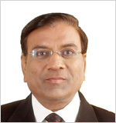

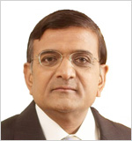
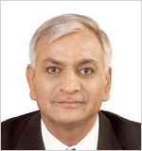
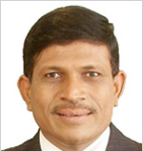
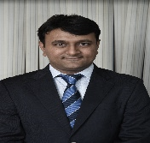
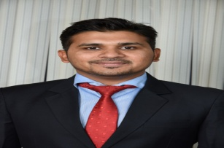
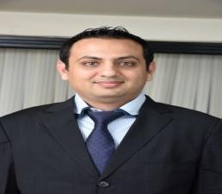
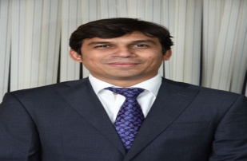
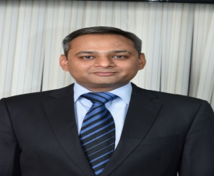
Strong Leadership Team to Deliver Long Term Growth
Experienced Leadership Team
Mr. Jayanti Patel
Executive Chairman
37 yrs of experience
Overseas international marketing
B.E (Chemical)
Mr. Ashish Soparkar
Managing Director
37 yrs of experience
Overseas corporate affairs & finance
B.E (Chemical)
Mr. Natwarlal Patel
Managing Director
35 yrs of experience
Overseas technical matters & marketing in Agrochemical division
MSc degree
Mr. Ramesh Patel
Executive Director
31 yrs of experience
Overseas purchasing function & liaisons with govt. / regulatory bodies
B.A degree
Mr. Anand Patel
Executive Director
28 yrs of experience
Overseas pigments marketing, manufacturing
BSc degree
Well-qualified Second Generation of Management
Mr. Ankit Patel
CEO (MOL)
10 yrs of experience
Executive Director at MFL
M.S. (Engg Management) from Australia & MBA from Singapore
Mr. Maulik Patel
CMD (MFL)
12 yrs of experience
Heads Basic Chemicals
M.S. (Chemical) &
MBA from USA
Mr. Kaushal Soparkar
MD (MFL)
11 yrs of experience
Heads Basic Chemicals
B.S (Chemical) and M.S (Engg Management) from USA
Mr. Darshan Patel
COO (Pigments) MOL
7 yrs of experience
Heads Pigments
M.S. (Engg Management) from Australia
Mr. Karana Patel
COO (Agrochemicals) MOL
11 yrs of experience
Heads liaisoning & procurement
Diploma & BSc (Chemical)

Slide 17
Discussion Summary
Q1 FY20 Results Update
About Us
Business Overview
Strategy & Outlook
Financial Overview

Slide 18
Pigments Business: Key Highlights
Established Business Profile
Vertically Integrated Manufacturing Facilities
Largest manufacturers of Phthalocyanine-based pigments with
14% global market share & amongst top 3 (capacity wise) global pigments players
Strong global presence in 70 countries,
Global distribution network - direct presence with subsidiaries in the US, Dubai and a representative office in China
Strong client relationships (90% business from repeat clients). High degree of product customisation, consistent quality and compliance regulations add to client stickiness.
Total Capacity – 32,940 MTPA
Location | Capacity (MTPA) | Products
GIDC Vatva, Ahmedabad | 2,940 | Pigment Green
GIDC Panoli, Bharuch | 17,400 | CPC Blue, Alpha and Beta Blue
Dahej SEZ | 12,600 | CPC Blue, Alpha and Beta Blue
Products Portfolio
Pigment Blue
CPC Blue
Pigment Green
Upstream product:
Sold to other pigments manufacturers
End products: Sold to industrial users
Robust demand due to multiple applications - printing inks, plastics, paints, coatings, textiles, leather, paper and rubber
Notes:
140+ 65+25+2012-13, 2013-14

Slide 19
Pigments Business: Operational Overview
Production (MT) & Capacity Utilisation (%)
Dispatch / Sales (MT)
Net Sales (Rs Mn)
EBITDA (Rs Mn) & EBITDA Margin (%)
82 %
75 %
68 %
79 %
81 %
Net Sales (excl. excise duty) including intersegment sales
Exports %
Notes:
140+ 65+25+2012-13, 2013-14

Slide 20
Pigments Business: Industry Overview
Global Pigments Market
Global Pigments Market Size (USD Bn)
The global pigments industry consists of three segments – organic,
in-organic and specialty pigment
Organic pigments account for 35-40% mkt. share out of total pigments industry
Organic pigments include Azo Pigments (yellow & red) (50-55% share), Phthalocyanine Pigments (blue & green) (20% share) and other Pigments (25-30% share)
Organic Pigments growth is linked to end-user industries mainly printing inks, paints and coatings and textile industries
4.5% CAGR
Demand Driver – Diverse Industrial Use
Paints & coatings and plastics industry have been the major growth drivers (especially from automotive sector)
India and China are fast becoming the centre of the global Organic Pigments market
India is leader in Phthalocyanine blue and green pigments
India’s pigment sales have been growing at 13-14% CAGR driven by exports due to India’s good quality products, stricter environmental standards and higher regulatory compliance
Notes:
140+ 65+25+2012-13, 2013-14

Slide 21


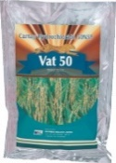
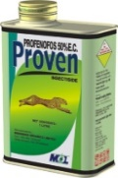

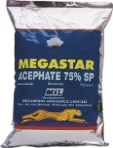

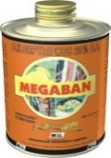
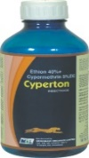







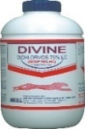
Agrochemicals Business: Key Highlights
Established Business Profile
Product Profile
Leading manufacturer of pesticides – products across entire value chain
Established global presence across Africa, Brazil, LatAm, US and Europe
Strong pan-India presence across 17 states, with ~2,800 stockists, agents, distributors, and dealers network
Major products – 2,4-D, Cypermethrin, Permethrin, Chlorpyrifos and Profenophos
Well-recognized formulation brands – Megastar, Megacyper,
Megaban, Synergy, Courage
Phase 1 Capex: Doubling 2,4-D Capacity by addition of 10,800 MTPA with capex of Rs 127 crores (Operational by June 2020).
Sold to technical grade pesticides manufacturers
Pesticide Intermediates
Technical Grade Pesticides
Sold to pesticides formulators
Bulk Packing
Sold to institutional customers
Pesticide Formulations
Brand Business
Sold to retailers, dealers, farmer societies
Branded Agrochemical Formulations
Vertically Integrated Manufacturing Facilities
Total Capacity – 28,260 MTPA
Location | Capacity (MTPA)
GIDC Panoli | 7,200
GIDC Ankleshwar | 6,420
GIDC Dahej | 14,640
Notes:
140+ 65+25+2012-13, 2013-14

Slide 22
Agrochemicals Business: Operational Overview
Registrations Base
Production (MT) & Capacity Utilisation (%)
Dispatch / Sales (MT)
581
567
616
462
492
Net Sales (Rs Mn)
EBITDA (Rs Mn) & EBITDA Margin (%)
71%
69 %
62 %
67%
74%
Exports %
Net Sales (excl. excise duty) including intersegment sales
Notes:
140+ 65+25+2012-13, 2013-14

Slide 23
Agrochemicals Business: Crop-protection Industry Overview
Global Crop Protection Market
Global Crop Protection Market (USD Bn)
The global crop protection market is set to grow steadily to reach
USD 58.7 Bn by 2020
Key drivers - growing population, declining arable land & rising pest concerns
Products worth ~USD 3 Bn to go off-Patent over 2017-20, gives strong opportunity to generic agrochemical players
India is the 4th largest global producer of Pesticides with an estimated market size of USD 4.9 Bn in FY17 after United States, Japan and China
The demand for agrochemicals in India is split in equal proportions between domestic consumers and exports
CAGR:2.8%
58.7
51.2
Pesticide Consumption is still Lowest in India
Kg per hectare
Source – Phillip McDougall
Notes:
140+ 65+25+2012-13, 2013-14

Slide 24
Basic Chemicals Business: Key Highlights
Established Business Profile
Vertically Integrated Manufacturing Facilities
7th largest (by capacity) Caustic-Chlorine producer in India
Latest 4th generation ‘Zero Gap Membrane Technology’ sourced from Asahi Kasei Chemical Corp, Japan
One of the most efficient caustic soda producers (CPP of 60MW)
Strategically located with close proximity to the port (importing coal) and customers (Caustic Soda & Chlorine supplied via pipeline), leading to lower logistics costs
New 60 TPD facility to manufacture Caustic Potash
Dahej Facility
Products | Capacity (MTPA)
Caustic-Chlorine | 166,600
Caustic Potash | 21,000
CMS | 40,000
Rs 6.4 Bn Capex Plan:
Strategic investment in 3 projects to expand basic chemicals business
Project 1: CMS project of 40,000 MTPA (commenced in July 2019)
- Produce MDC, Chloroform and Carbon Tetra Chloride
Project 2: Expansion of Caustic Soda capacity to 2,71,600 MTPA and CPP capacity to 96 MW (operational by Q3FY20)
Project 3: Hydrogen Peroxide capacity of 30,000 MTPA (operational by Q3FY20)
The expansion will be margin accretive at company level due to higher EBITDA margins in the basic chemicals business
Products Profile
Caustic Soda
Used in soap & detergents, pulp & paper, textiles processing, Organic & Inorganic Chloro solvents
Chlorine
Used in PVC manufacturing, alumining, dyes & dyes intermediates, organic & inorganic chemicals, drinking water disinfection, pharmaceuticals
Caustic Potash
Used in Soaps, Detergents, Fertilizers Chemicals
CPP: Captive Power Plant, CMS: Chloromethane, MDC: Methylene dichloride
Notes:
140+ 65+25+2012-13, 2013-14

Slide 25
Basic Chemicals Business: Operational Overview
Production (MT) & Capacity Utilisation (%)
Dispatch / Sales (MT)
Net Sales (Rs Mn)
EBITDA (Rs Mn) & EBITDA Margin (%)
Net Sales (excl. excise duty) including intersegment sales
Notes:
140+ 65+25+2012-13, 2013-14

Slide 26
Basic Chemicals Business: Industry Overview
Global Chlor-Alkali Market
Global Chlor-Alkali Market Size (USD Bn)
The global Chlor-Alkali industry is expected to grow at 5.3-5.9% CAGR (2017-2023), to reach USD 125 Bn by 2023
The global demand for Chlor-Alkali products will continue to grow driven by diverse industrial uses - glass, alumina, vinyl, water treatment, polyvinyl Chloride (PVC) plastics, soaps, detergents, pulp and paper, textiles etc
APAC region will continue to dominate the market due to its growing economies, increasing infrastructure and manufacturing base and large population base
Indian Chlor-Alkali Industry is poised to grow a CAGR of 6.5% during 2017-2022
The Indian Caustic industry is a well-established mature industry with a capacity of 3.8 Mn MTPA (Caustic Soda) and an annual turnover of Rs 70 Bn
The Indian industry is regarded by global peers as being among the most efficient, eco-friendly and progressive industries
5.9% CAGR
Demand Driver – Diverse Industrial Use
Notes:
140+ 65+25+2012-13, 2013-14

Slide 27
Discussion Summary
Q1 FY20 Results Update
About Us
Business Overview
Strategy & Outlook
Financial Overview

Slide 28
Revenue Target Rs 10 Bn From Each Business Segment
Basic Chemicals
Agrochemicals
Pigments
This is MOL’s high margin segment
The Rs 6.4 Bn on-going capex plan provides a
solid revenue growth visibility over coming years
Continue to leverage the market leadership position and capitalise on domestic market demand
MOL’s backward integrated facilities puts it in an advantageous position, given the current rising raw material prices from China
Phase 1 Capex: Doubling 2,4-D Capacity by addition of 10,800 MTPA with capex of Rs 127 crores (Operational by June 2020).
Expand branded products portfolio
MOL is one of the largest producer of phthalocyanine pigments
Diversify into new pigment products
Continue to focus on increasing domestic presence and capture market share
Notes:
140+ 65+25+2012-13, 2013-14

Slide 29
Discussion Summary
Q1 FY20 Results Update
About Us
Business Overview
Strategy & Outlook
Financial Overview

Slide 30
Last Five Years Summary
Rs Mn
Revenues * & Gross Margin
Revenues - Segment Breakup
CAGR 13%
EBITDA & EBITDA Margin
PAT & PAT Margin
CAGR 28%
CAGR 59%
Revenues net of excise duty, P&L for FY14 & FY15 are I-GAAP while FY16 – 19 are IND-AS
Notes:
140+ 65+25+2012-13, 2013-14

Slide 31
Last Five Years Summary
Rs Mn
Leverage Analysis
Working Capital Analysis *
Return on Capital Employed
Return on Equity
* Calculated on Net Sales, ROCE = EBIT / Average Capital Employed (Debt + Equity + Minority Interest), ROE = PAT / Average (Equity + Minority Interest)
Notes:
140+ 65+25+2012-13, 2013-14

Slide 32
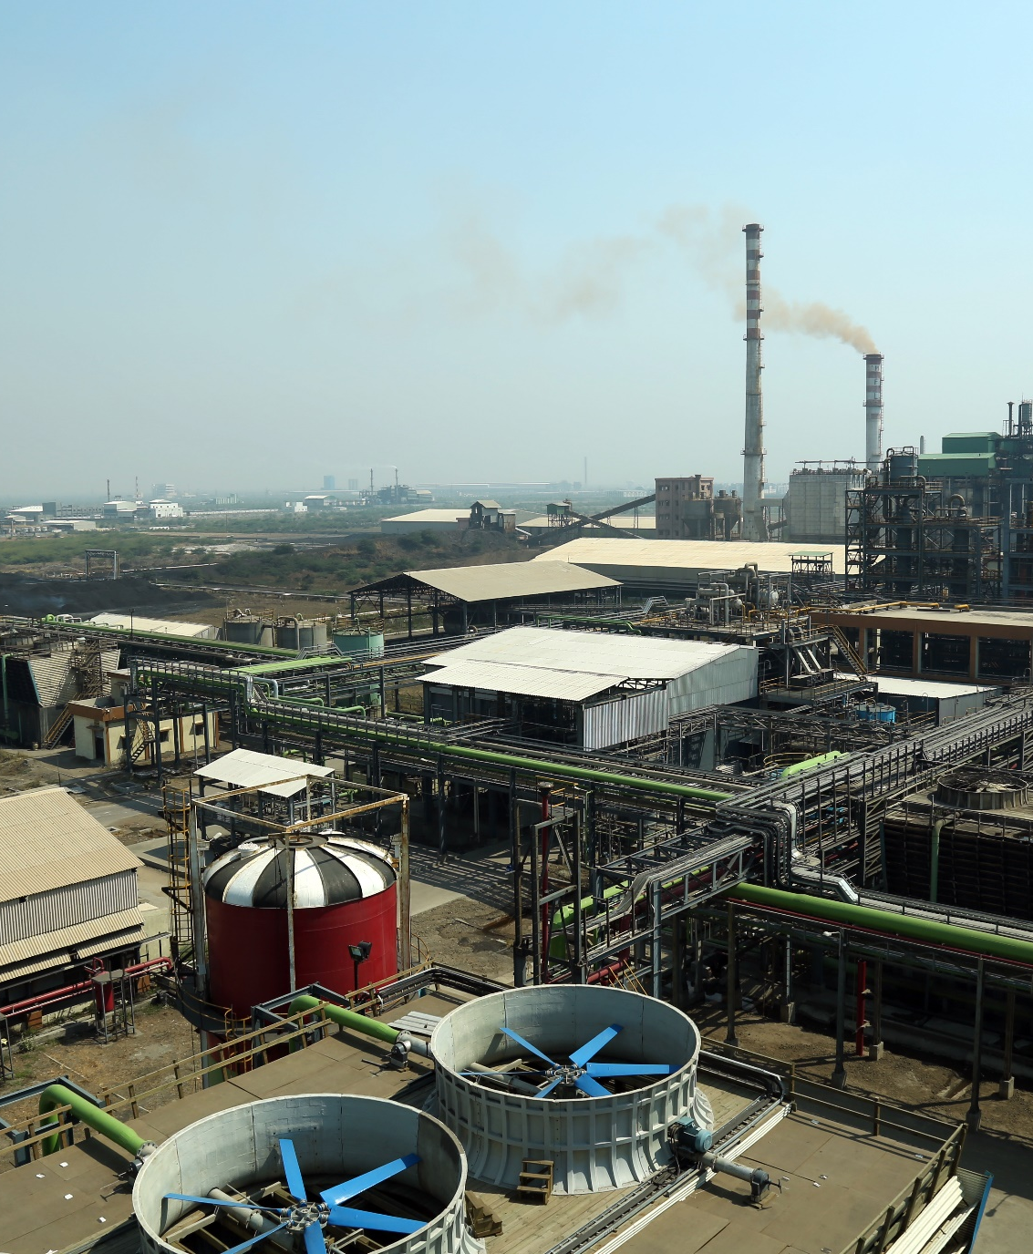

For Further Queries:
Gurjant Singh Chahal, CFO
Email: ir@meghmani.com
Phone: +91-79717 61000
Hiral Keniya / Mehul Mehta
IR Consultant
Contact: 90296 62801 / 98920 62162
Email: hiral.keniya@dickensonworld.com
mehul.mehta@dickensonworld.com

